Slide 1
Location-Aware Adaptive Vehicle
Dynamic System

Slide 2
Contents
LAAVD System Overview
Simulation Setup
Track Design
Simulation Environment

Slide 3
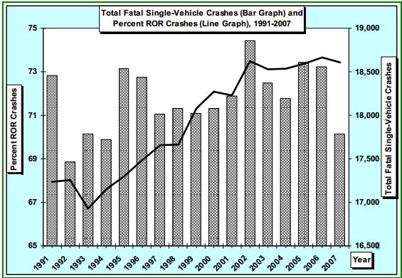
According to a Department of Transportation study, over 17,000 Single-Vehicle Crashes every year result in death.
Notes:
Study is Liu, C. and Submaranian, R. (2009) “Factors Related to Fatal Single-Vehicle Run-Off-Road Crashes”, DOT HS 811 232.
In ¾ of these years, there were over 18,000 single-vehicle crashes
“These are the accidents our system is helping to prevent”

Slide 4
LAAVD System
Predictive Performance Enhancement
Collect data on dangerous roads
Determine user’s performance margin
Use data to determine if the user is likely to crash
Silently modify user’s input (acceleration, brakes, tire angle) to avoid accident
Notes:
Collect data from crash reports
Define Performance Margin, why it’s important
Use data including performance margin, GPS location, speed, acceleration, and other factors.

Slide 5
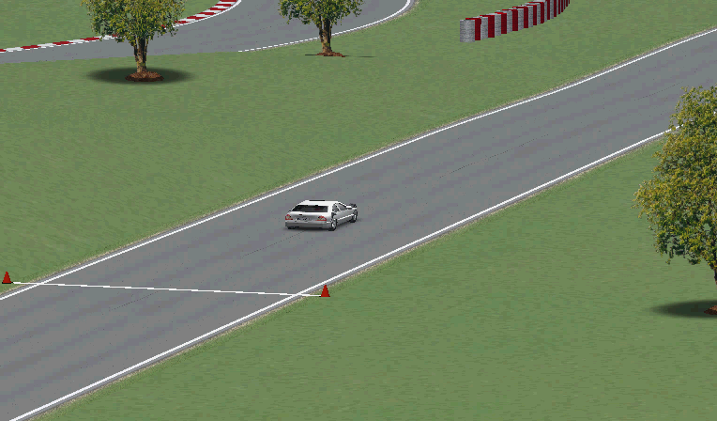

Slide 6
LAAVD System
Simulation
Developing a realistic driving simulation to showcase the intervention software.
Designing a track based on real conditions that are likely to influence single-car accidents.
Notes:
Realistic involves realtime simulation, actually have someone controlling the car
Track conditions that may cause people to lose control of their car such as variable-radius turns and sharp, unseen turns.

Slide 7
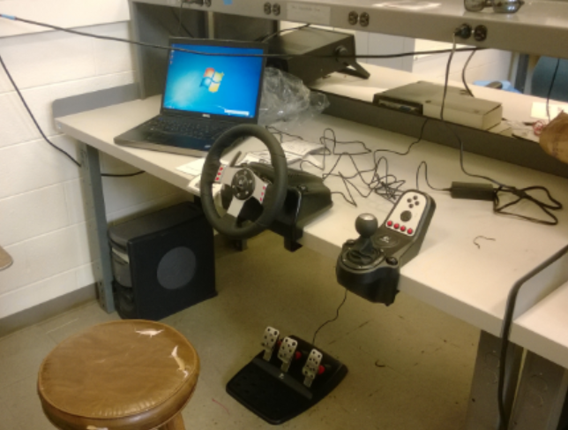
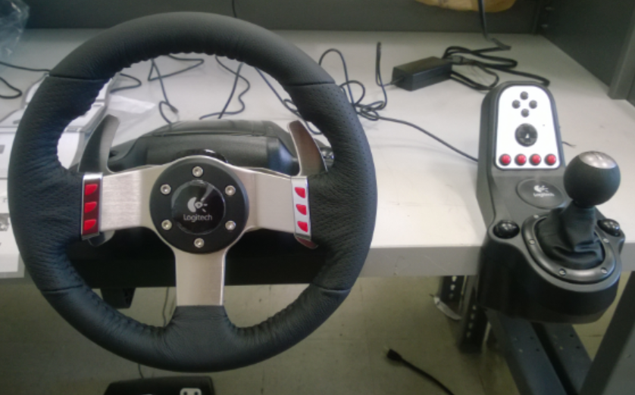
Simulation Setup
Simulation running on Laptop
User input on Logitech G27 Racing Wheel

Slide 8
Next Steps
Create a realistic user interface for our simulation
Create the simulated track that we will be driving on
Constantly improve vehicle model to be more realistic
Implement our Intervention Strategy to show that it will improve user performance

Slide 9
Track Design
Our driving simulator will be accompanied by tracks custom made to demonstrate the functionality of our Predictive Correction system in realistic driving environments

Slide 10
Goals
Track must demonstrate prevention system in effect
Must create situations in which the human driver will likely fail if unaided
Situations for failure must be based on realistic challenges of real-world roads

Slide 11
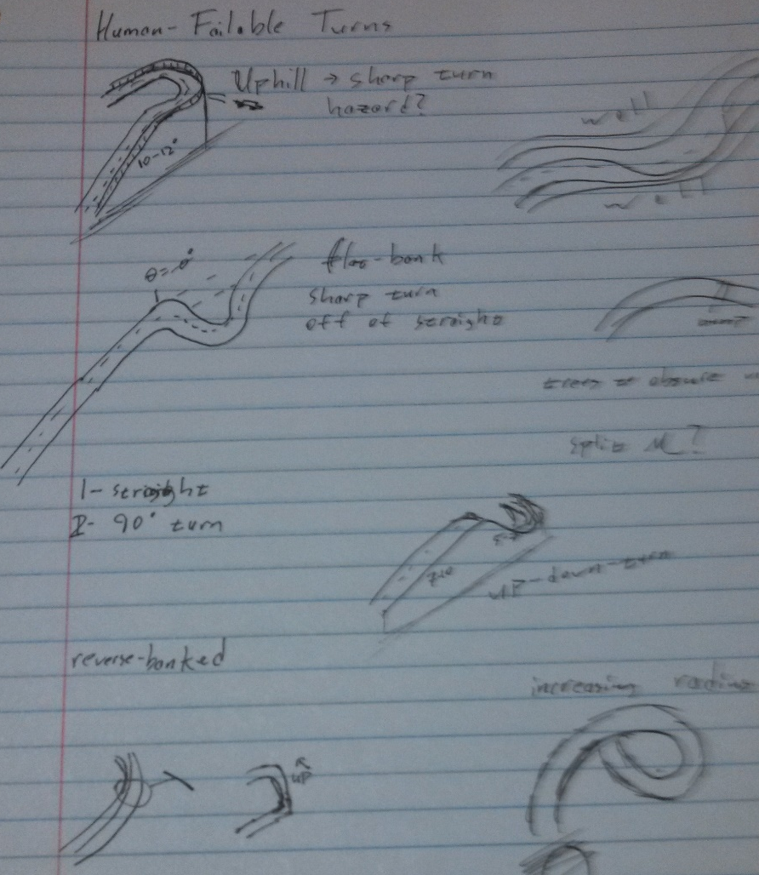
Realistic Road Hazards
Must focus on hazardous features common on standard highways and state roads
Visibility obstruction a common theme in hazardous road features
While the human driver may not asses (or even see) these turns correctly, our correction system will
http://www.mathworks.com/cmsimages/58961_wl_sm_3danim_fig1_wl.jpg

Slide 12
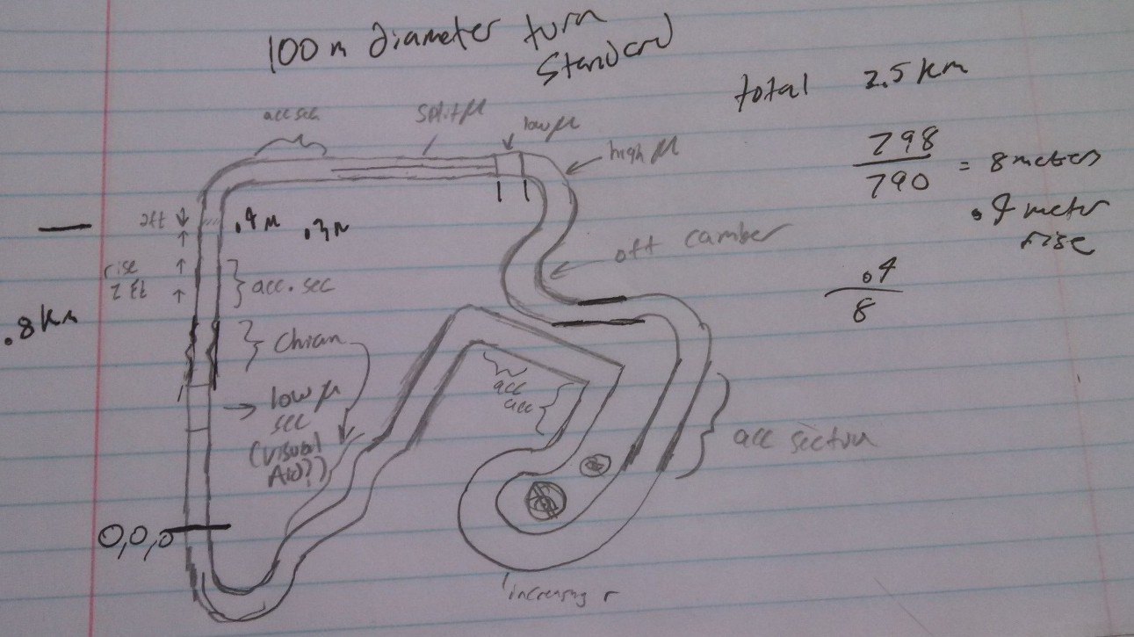
Current Drafts Pt.1
Inspired by traditional race circuit
Promotes a race environment to push car to speeds where Preventive Correction will be required to make turns
Designer: Brian Davidson (Senior – ME)

Slide 13
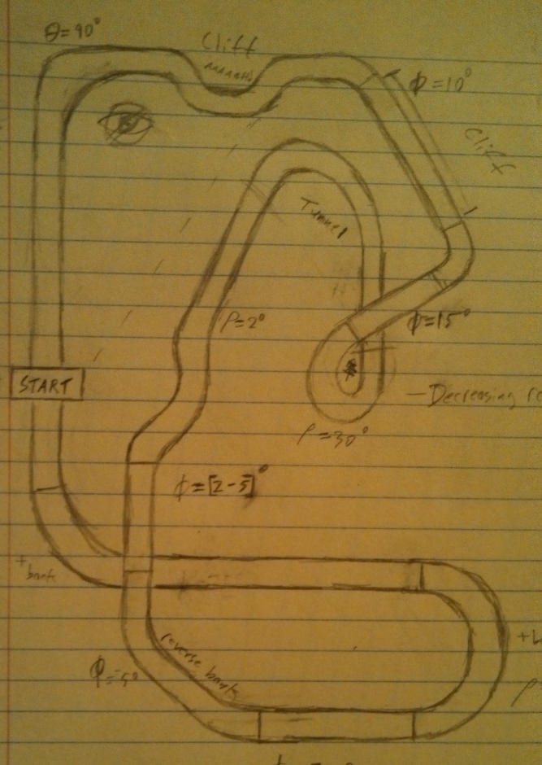
Current Drafts Pt. 2
Inspired by mountain road hazards
Remains faithful to traditional race circuit design
Utilizes heavy visibility restriction for human driver difficulty
Designer: Dirk Hortensius (Senior – CS)
http://www.mathworks.nl/help/releases/R2013b/sl3d/examples/vr_octavia_graphs_02.png

Slide 14
Further Considerations
Track does not have to be a circuit. This will allow us to properly emulate mountain road conditions common in single-vehicle accidents
Our current simulator prototype design does not support changes in road friction. In later track designs, this may be implemented to represent traction hazards common in winter driving conditions (black ice, slick turns, etc.)

Slide 15
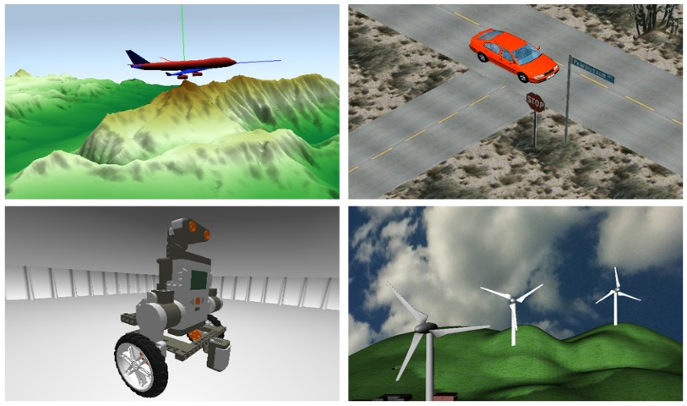
Simulation Environment
Chose to use Simulink 3D for first simulation.
May develop in other software in the future (Unity, rFactor, etc.)
http://www.mathworks.com/cmsimages/58961_wl_sm_3danim_fig1_wl.jpg

Slide 16
Simulation Environment
Pros:
Environment natively communicates with car model.
Will be easy to maintain and update (improve MATLAB model but simulation environment stays the same).
Cons:
Not as visually immersive.
Almost all development (Environment, Physics, etc.) is in house.
Does not natively understand controller inputs or haptic feedback
Does Volkswagen have a preferred Simulation environment?

Slide 17
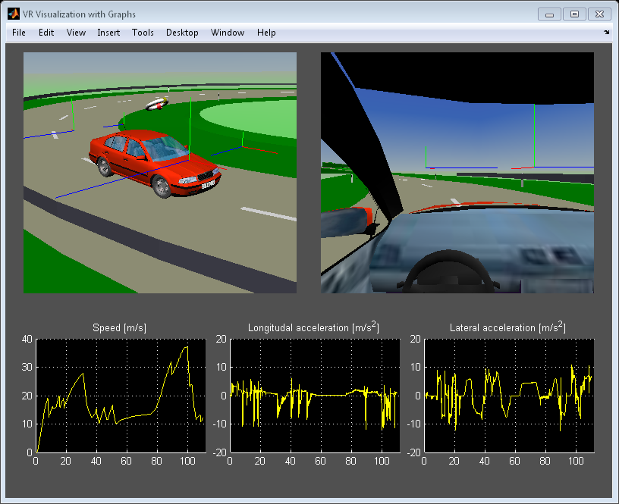
Simulation Environment
http://www.mathworks.nl/help/releases/R2013b/sl3d/examples/vr_octavia_graphs_02.png

Slide 18
